Slide 1

MINI PROJECT (2020-2021)
Face-Recognition-Attendance-Management –System
Institute of Engineering & Technology
Submitted by -
Suraj Garg
Dharmendra Sharma Astik Singh
Adarsh Kumar Dixit
181500735
181500215
181500158
181500038
Supervised by :-
Mr. Vinay Agrawal
(Assistant Professor)

Slide 2

Introduction
Face Recognition
Face Identification
Implementation
Image Acquisition
Screenshots
Flowcharts
Teacher’s login id password
Student’s registration
Take student’s attendance

Slide 3

Traditionally, student’s attendances are taken manually either by using attendance sheet or by calling names of the students one by one which indeed is time consuming.
Moreover, it is very difficult to verify each student one by one in a large classroom environment with distributed branches whether the authenticated students are responding or not.
FACE RECOGNITION technology is gradually evolving to a universal biometric solution since it requires virtually zero effort from the user end. It is accurate and allows for high enrolment and verification rates.

Slide 4

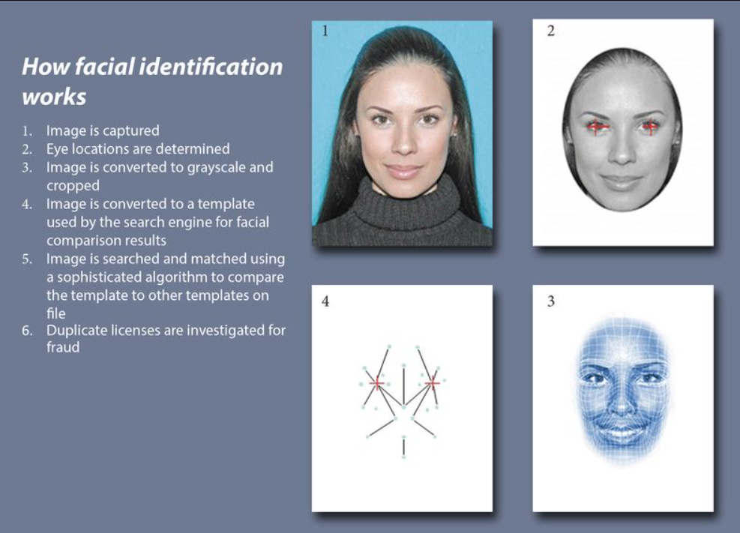

Slide 5
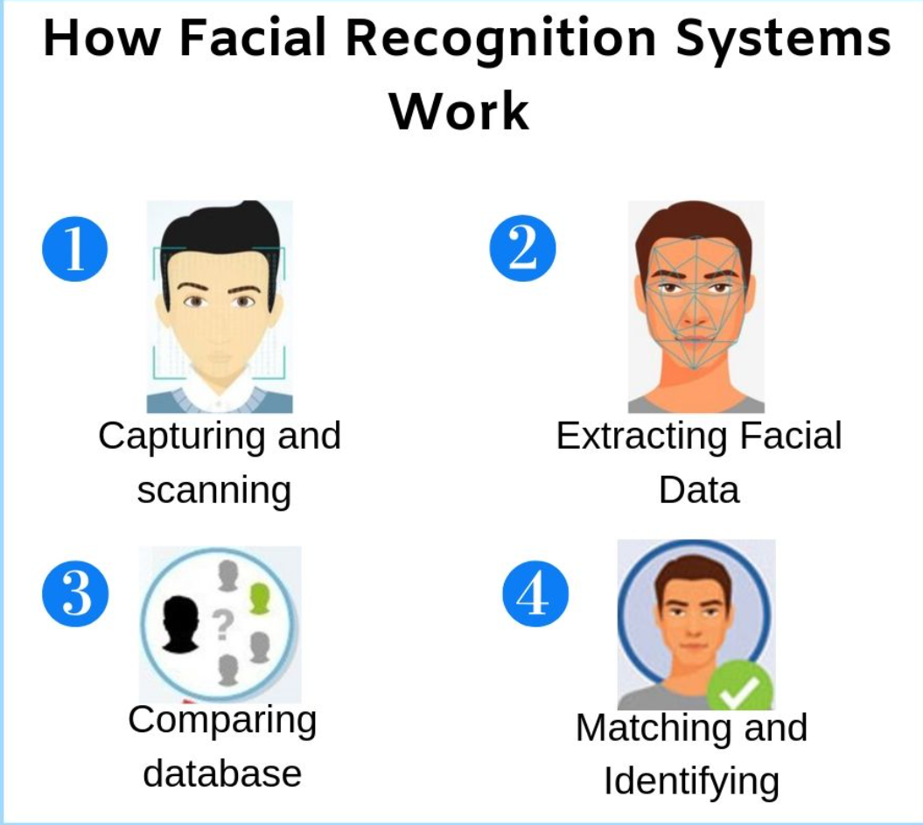

Slide 6
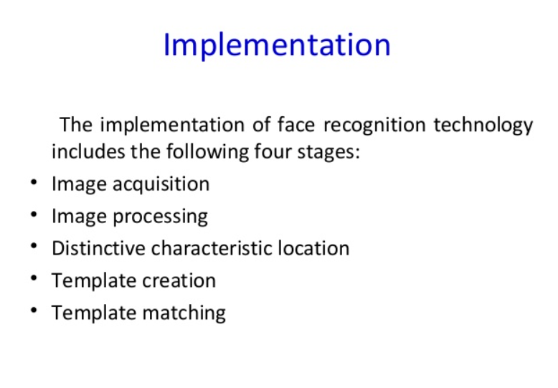

Slide 7
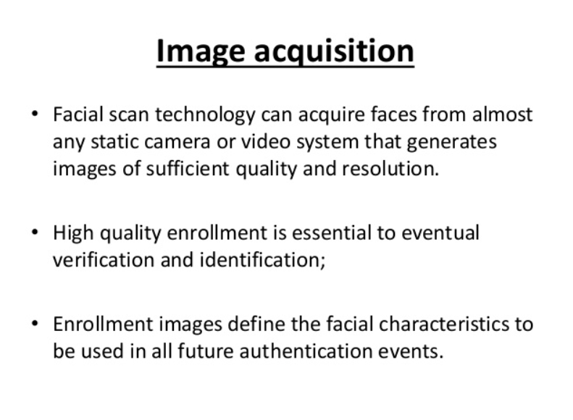

Slide 8
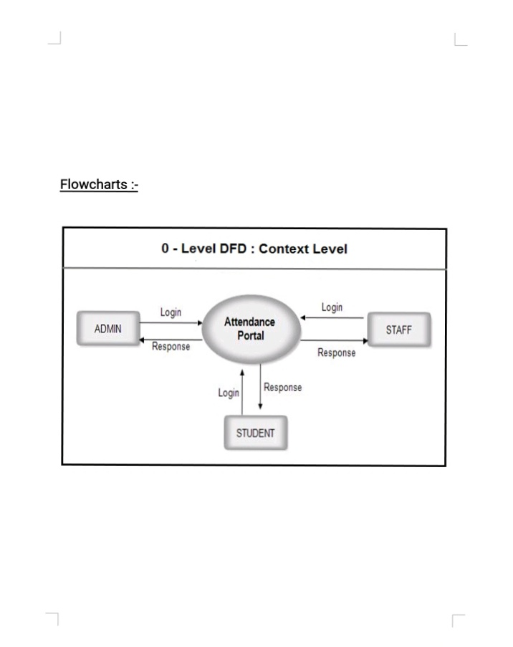
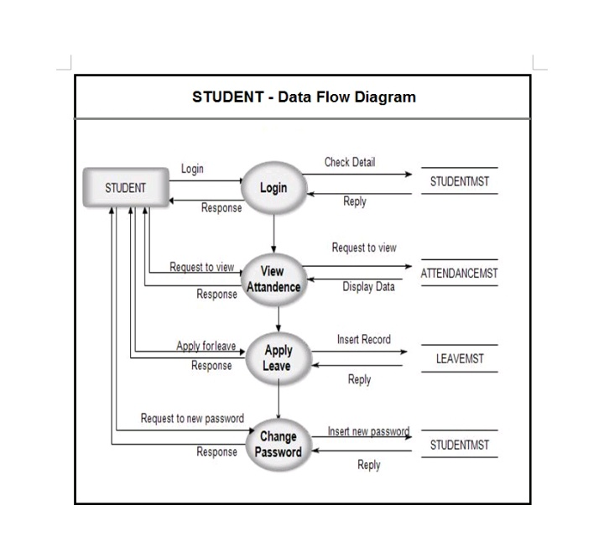
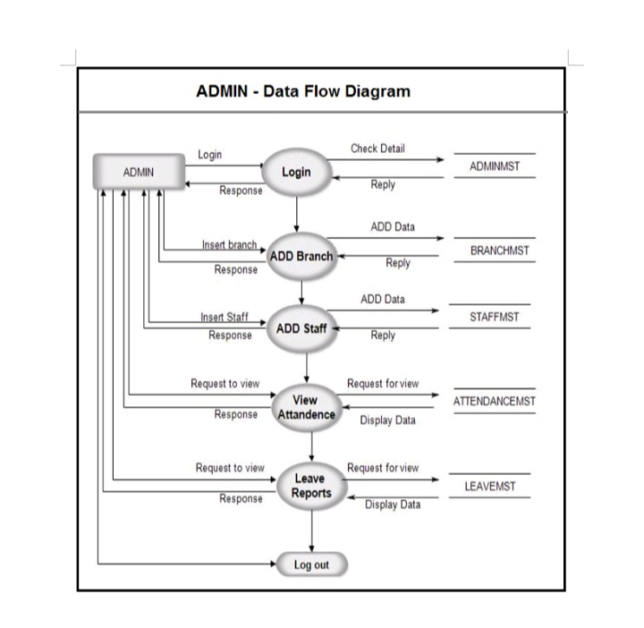
Flow chart and algorithm

Slide 9
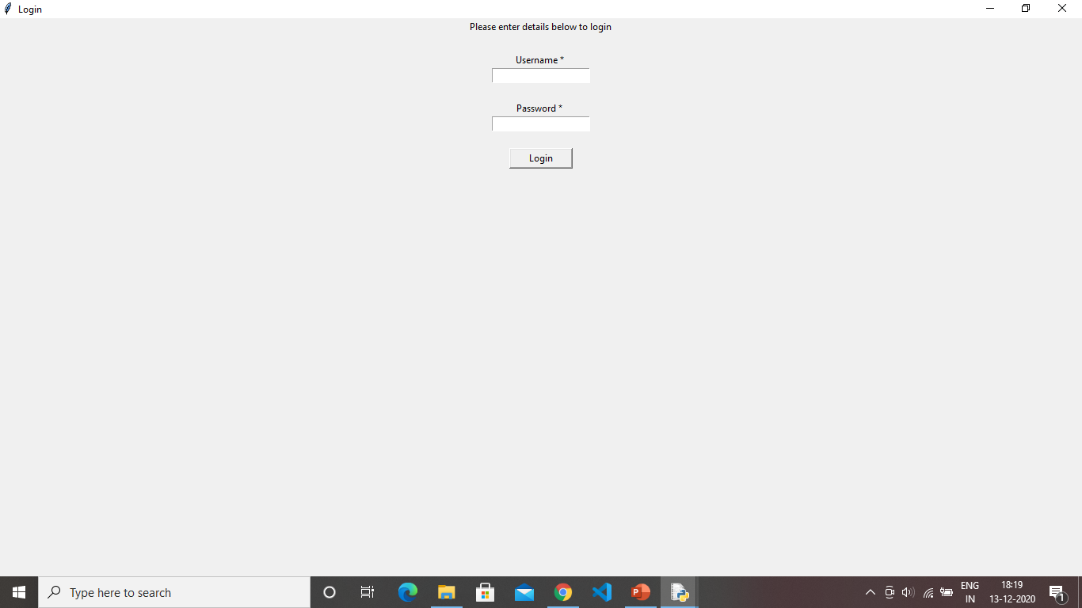
Teacher id and password

Slide 10
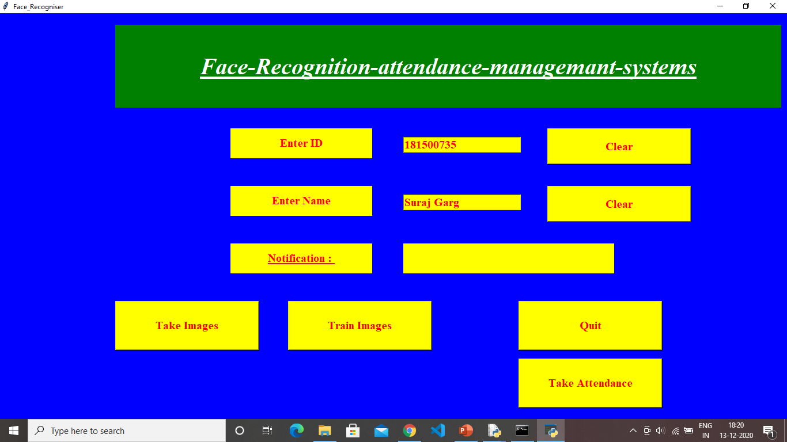
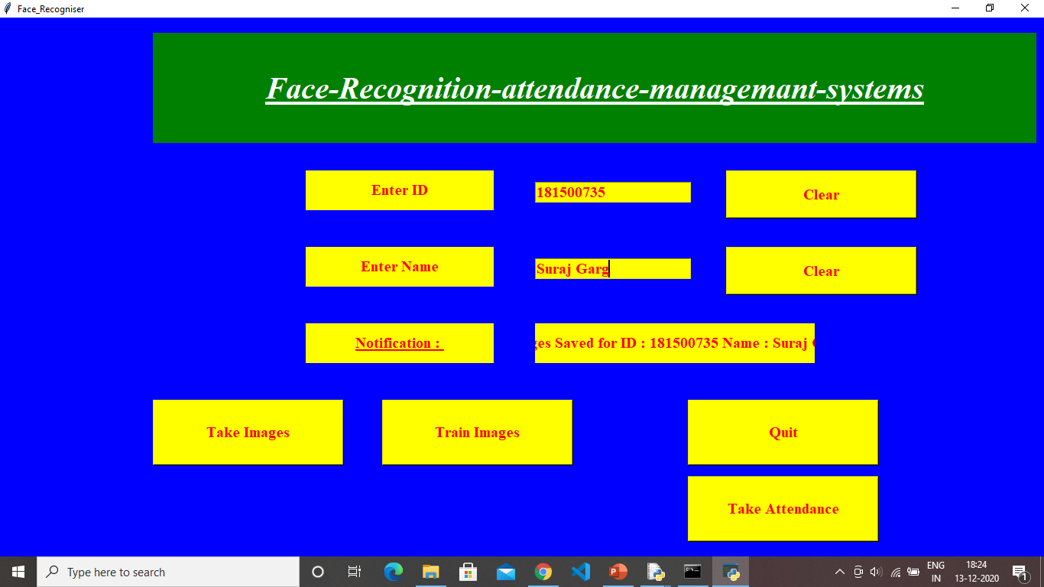
Student’s Registration

Slide 11
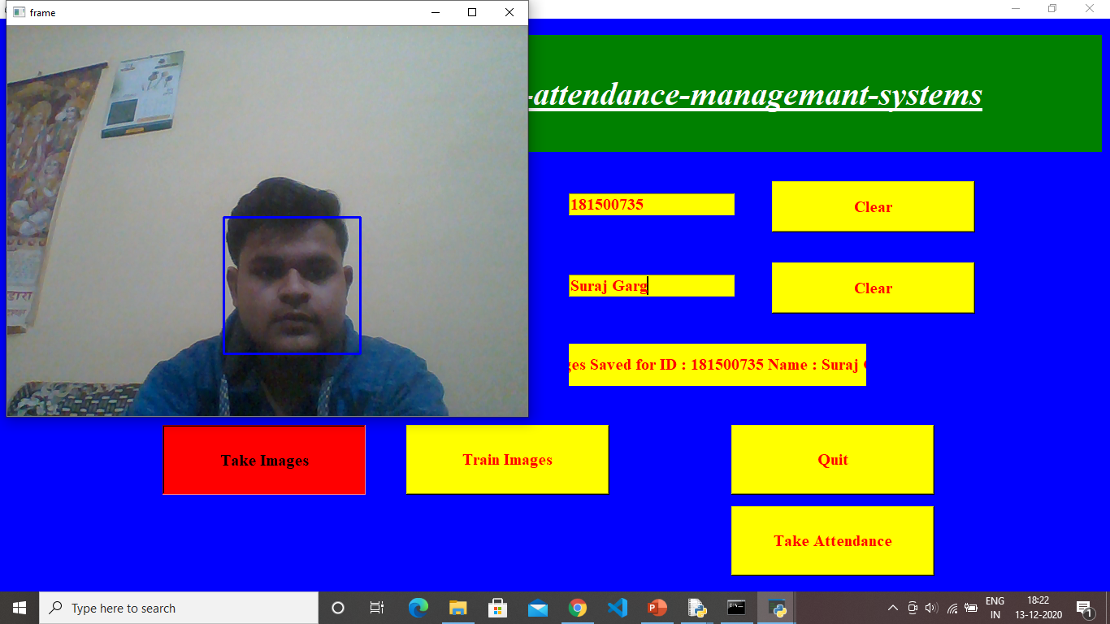
Student’s image capture

Slide 12

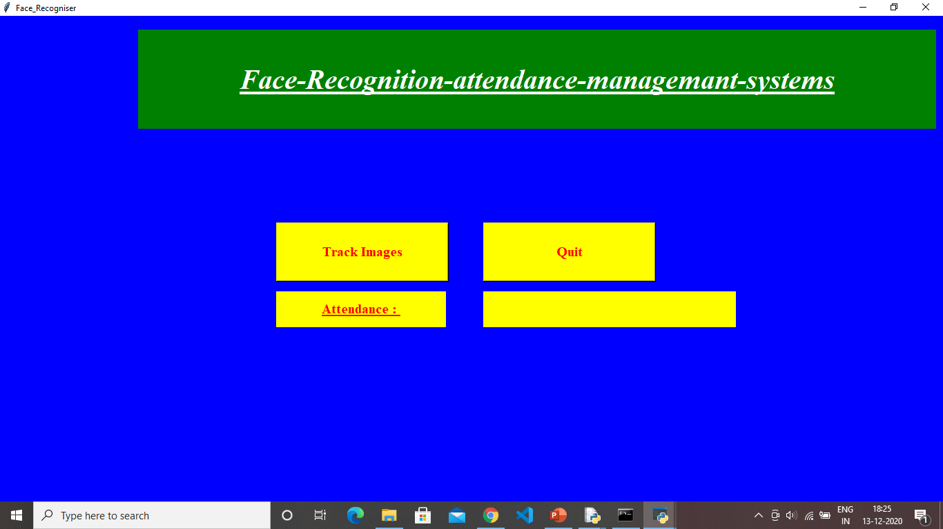
Student’s take attendance

Slide 13
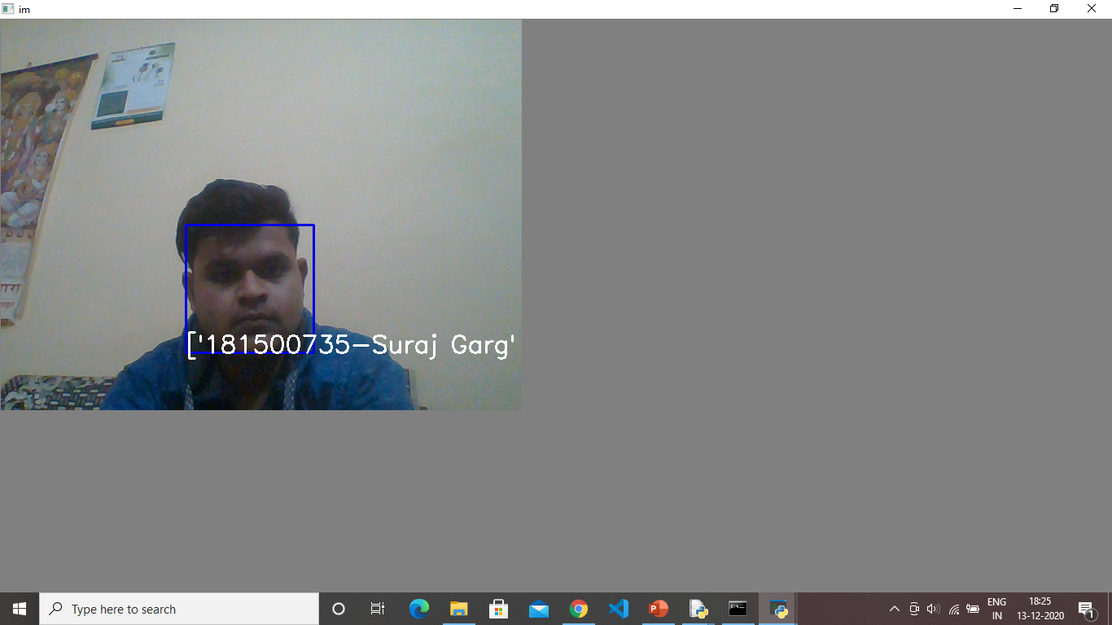
Show student attendance

Slide 14
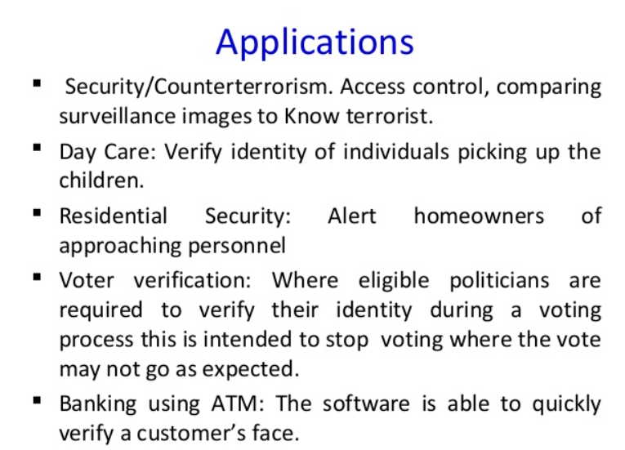

Slide 15


